Slide 1
Drug - Target Interactions

Slide 2
Drug-Target Interaction Prediction
Mentor:
Dr Ramesh Saha

Slide 3
Table of contents
01
02
03
04
05
06
07
Introduction
Drug-Target Interactions
Problem
Statement
Procedure
Web Scraping
Preprocessing
08
GCNN Model
References

Slide 4
Introduction
Drug: Any substance (other than food) that is used to prevent, diagnose, treat, or relieve symptoms of a disease or abnormal condition is a drug.
Target/Protein: Targets/Proteins are the large biomolecules and macromolecules that are made up of one or more long chains of amino acid residues.
Drug-Target interactions: The protein is targeted by drugs to enhance or inhibit the function carried out by protein.

Slide 5
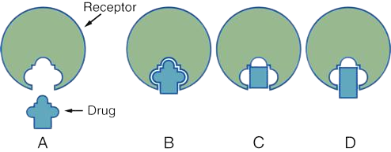
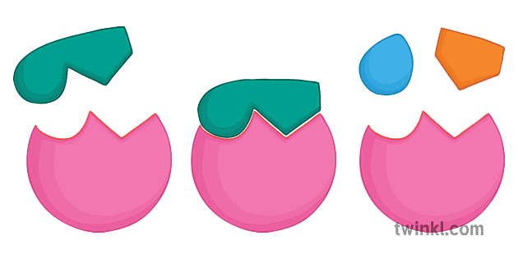
Drug-Target Interactions
A drug is small in comparison to a protein.
The better the fit of the ligand to the protein binding site, the more potent the drug can be.
Here, we will use Graph Convolutional Neural Networks (GCNNs) for predicting drug targets.

Slide 6
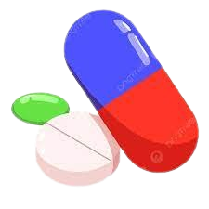
Problem Statement
Graph Convolutional Neural Networks (GCNNs) to increase the accuracy of results.
Improving the size of potential target space.
Improving the quality of training data set.

Slide 7
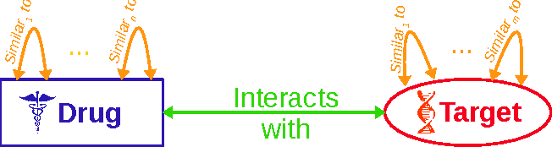
Objectives
Predicting the binding affinity between compounds and proteins with considerable accuracy is essential in drug discovery.
Using Graph Convolutional Neural Networks (Graph CNNs) for predicting drug targets.
Improving drug discovery efficiency.
Exploring multiple properties of a drug.

Slide 8

Procedure
We have used the database Biosnap for the data.
Here we get the dataset in 3 files namely test, train, validation in csv formats.
We will combine all these files and subject
them to web scraping.

Slide 9
Web scraping
In web scraping , we generally convert the drugs into its drug SMILES and proteins into its protein sequences.
We use different urls for this particular conversion
For drug, URL : "https://go.drugbank.com/drugs/"
For protein, URL : "http://www.uniprot.org/uniprot/"
Next, we get 2 different datasets for drug smiles and protein sequence i.e drug_ID.txt and prot_ID.txt
respectively.

Slide 10
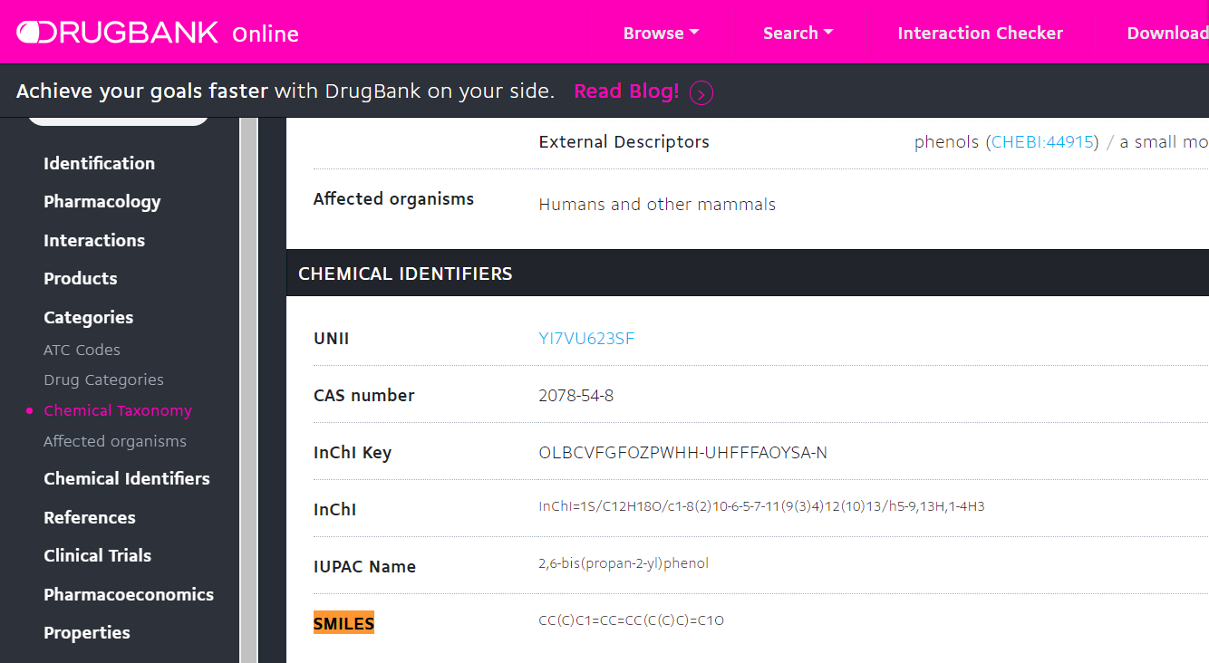
We will get generated data.csv file after web scraping.

Slide 11
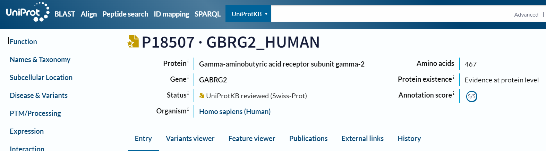
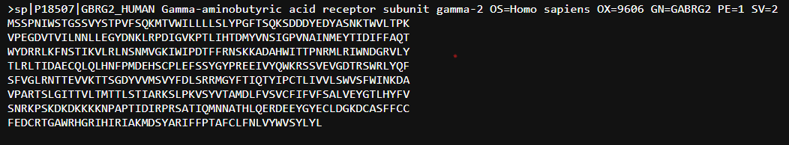
Protein sequence:

Slide 12
Preprocessing
In preprocessing, data.csv file contains drug molecular formula followed by protein sequence.
We convert drug smiles and protein sequences into their respective molecular graphs.
As our target is to make these drug-target interaction undergo GCNN , so we convert the dataset into molecular graphs.

Slide 13
For drugs, we extract features such as symbol, degree, chirality, total number of hydrogens, formal charge, Implicit valence, Aromaticity.
For Proteins, we enumerated the structure into sequence format.
Here, we are using Graph function from networkx module to convert drugs and proteins into respective graphs.

Slide 14
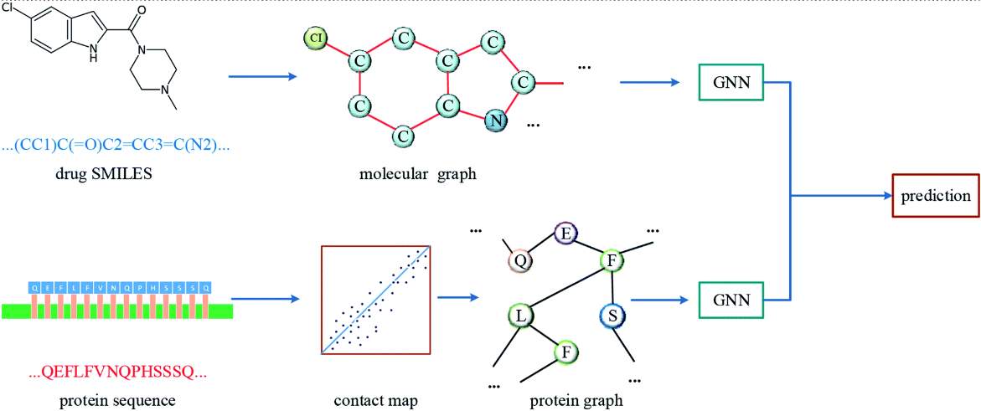
Illustration of DTIs on GCNNs:

Slide 15
How the features will look like?
Here, we are using graph function from networkx module to convert the drugs and proteins into graph format.
However, a file with .pt extension os created which cannot be opened to visualise the graph structures.
For that reason, we have created another code just to represent the features of drugs and proteins.

Slide 16
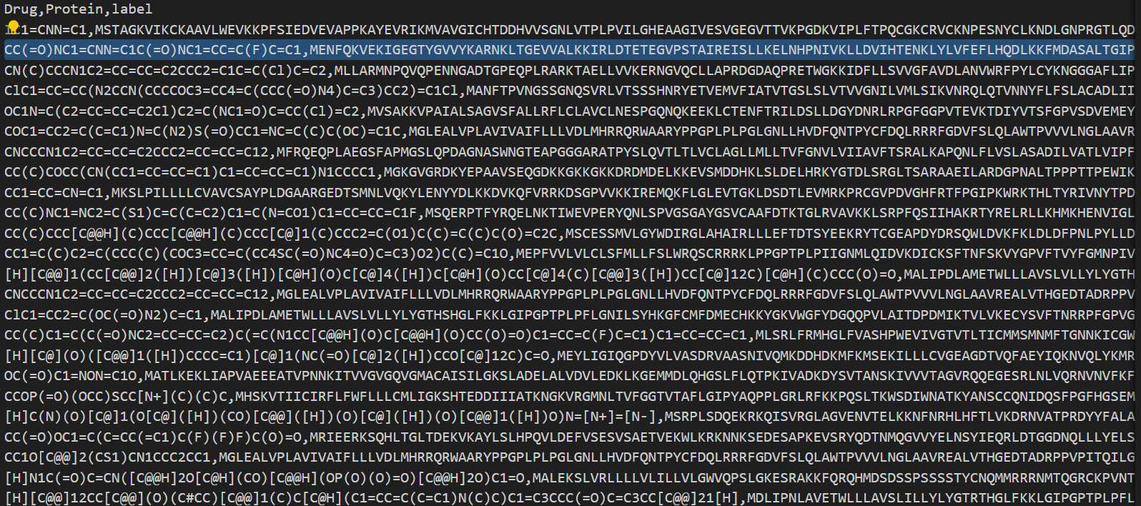
Data.csv file:

Slide 17
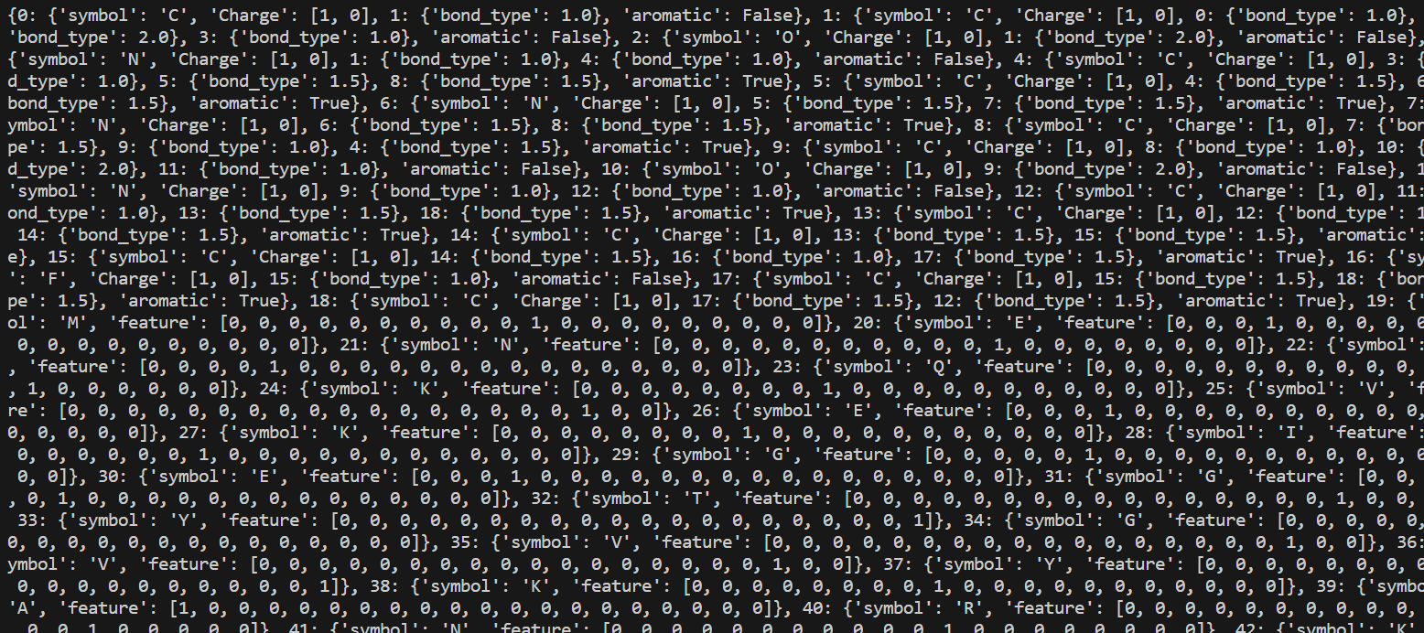
Representation of features:

Slide 18
Drug Target Interaction Model:
Here, we created model for binary classification of drug target interactions using GCNNs.
We will load the preprocessed dataset generated from preprocessing which contains the data in graph format.
We have used three convolutional layers and passed features of drugs and proteins which are generated from preprocessing.

Slide 19
We have mentioned the number of epochs in the code. The code will be executed multiple times based on this number of iterations.
For each iteration (Epoch), we are representing training loss, training accuracy, and validation accuracy.
Precision, Recall, F1 score, and Testing accuracy are obtained at the last step.
Accuracy - 83.72%

Slide 20
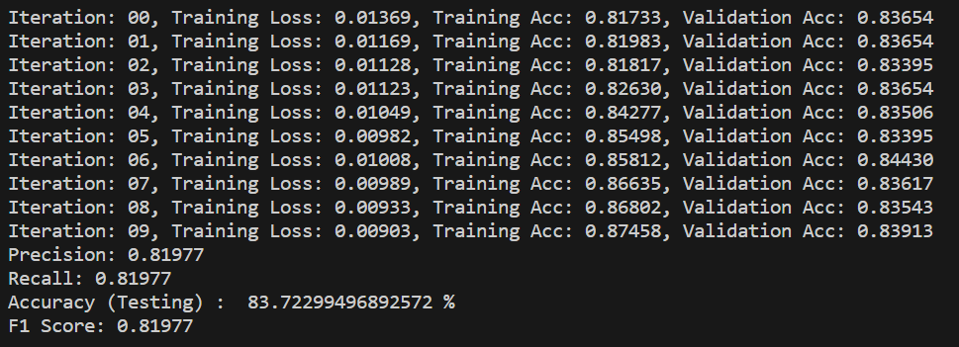
Results:

Slide 21
References:
DTiGEMS+: drug–target interaction prediction using graph embedding, graph mining, and similarity-based techniques (Maha A. Thafar, Rawan S. Olayan, Haitham Ashoor, Somayah Albaradei, Vladimir B. Bajic , Xin Ga , Takashi Gojobori and Magbubah Essack).
Graph Convolutional Neural Networks for Predicting Drug-Target Interactions (Wen Torng and Russ B. Altman).
DeepNC: a framework for drug-target interaction prediction with graph neural networks (Huu Ngoc Tran Tran, J. Joshua Thomas and Nurul Hashimah Ahamed Hassain Malim).

Slide 22
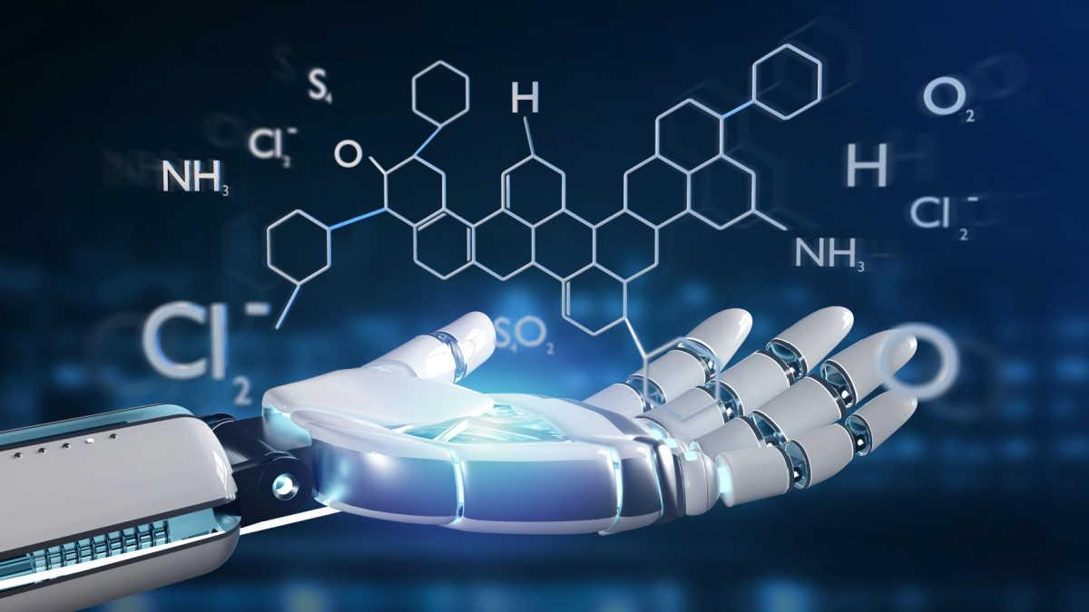
Team:
Ginjupalli Srikanth
(12012042)
Parimi Vignesh
(12012025)

Slide 23
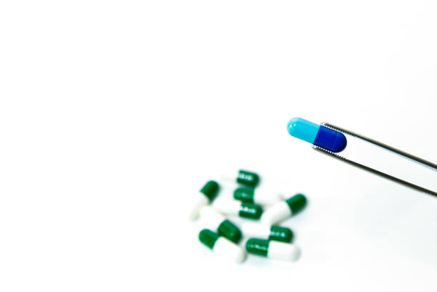
THANK YOU

